Slide 1
Multi-Channel Receiver Analyzer
Breana Branham
in the ASU Low-Frequency Cosmology Laboratory
Mentor Professor Judd Bowman
Special thanks to Hamdi Mani and Jose Chavez

Slide 2
Outline
Radio Telescopes
The Murchison Widefield Array
Explanation of Device
Creation of Device
Project Completion
Notes:
Outline:
Introduction to a Radio Telescope
Stuff that comes after that

Slide 3
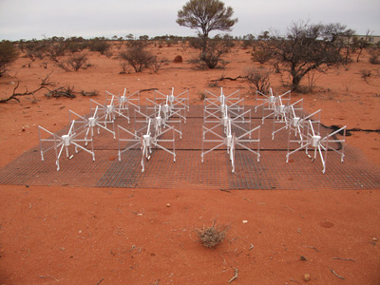
The Murchison Widefield Array (MWA)
Radio Telescopes
Research Goals of MWA
Combining signals using beamformer
Creating an automated device to feasibly test all tiles
http://www.icrar.org/
Notes:
Talk about the telescope and its research goals; then, about the structure of the telescope to segue into what I’m doing and how it’s useful.
2 minutes about what a radio telescope is and how the MWA works.
What it is this thing is going to be connected to.
Radio telescope for astronomy, works differently from optical telescopes.
Here you have to combine signals from many antennas.
Process them electronically. All these cables that have to be connected to all the antennas.
Device called the beamformer that combines them.
Talk about the beamformer and what it does.
Establish the project. What this device has to do. Has to connect to a network analyzer, which can only test one path at a time to a device that has 32 different paths and automatically switch between them in order to make it feasible to test hundreds of these things.
My project was to build a test device to test beamformers.

Slide 4
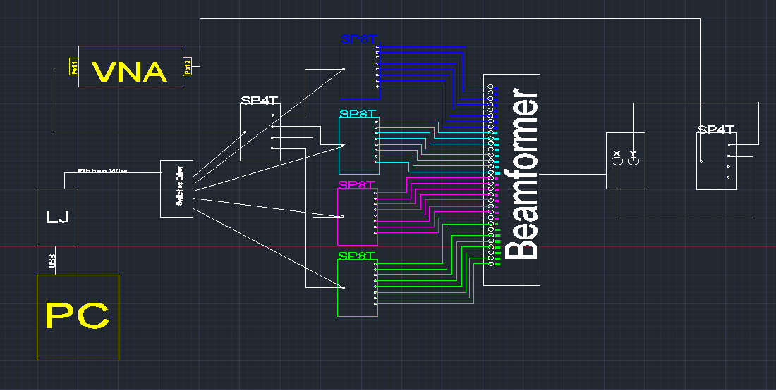
Initial Device Design

Slide 5
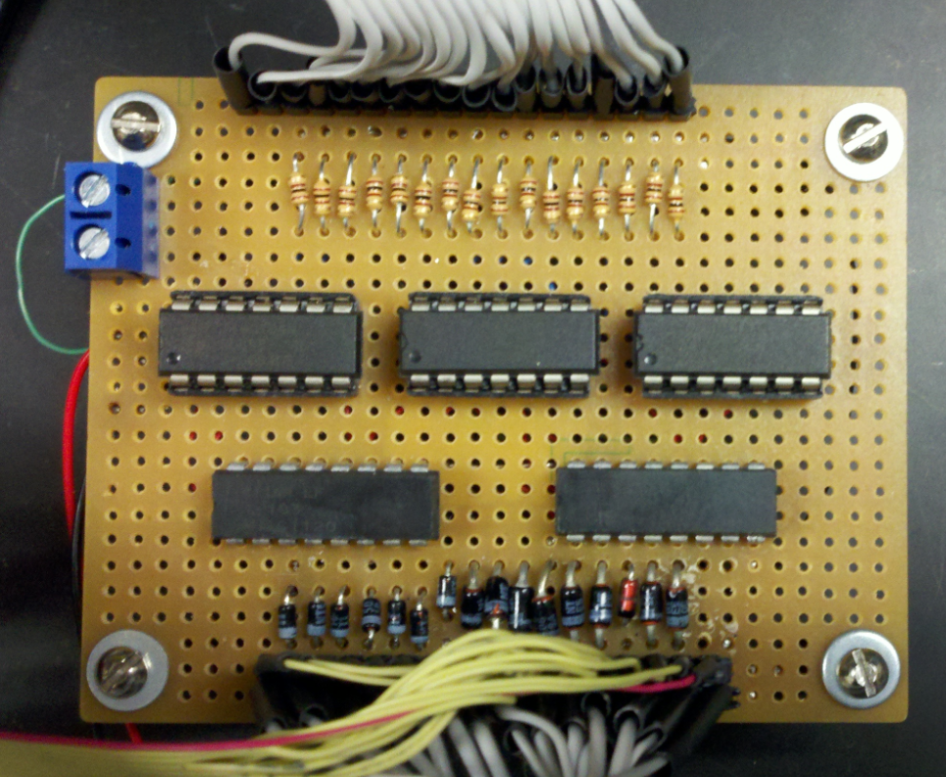
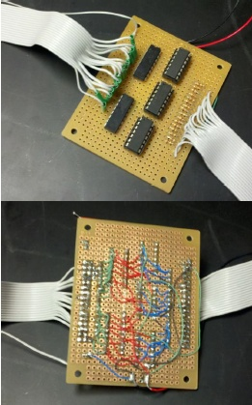
Building Components
Inverts the voltage to power the negative logic switches
Circuit Design
Soldering
Testing
Troubleshooting
Notes:
New Pictures of Switch Driver

Slide 6
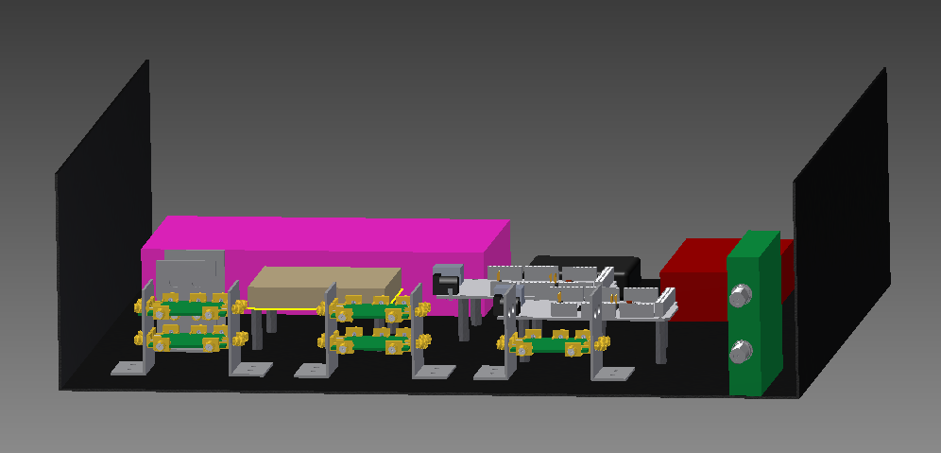
3D Model

Slide 7
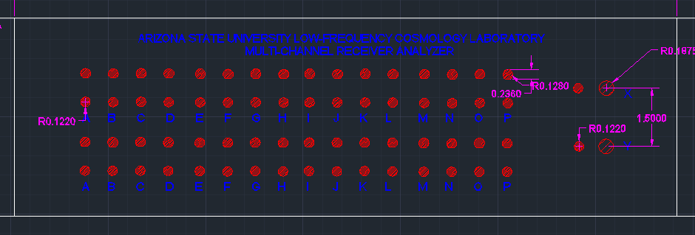
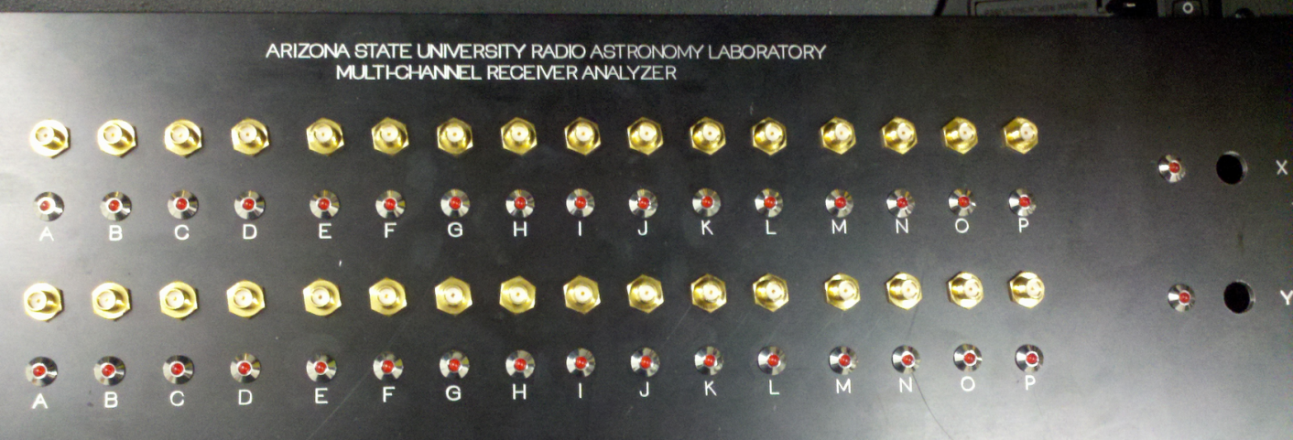
Creating the Exterior
AutoCAD Drawings
Machine Shop
Add LEDs and SMA connectors
Notes:
Titles; simple bullets
Delete the back and put a picture of the new one

Slide 8
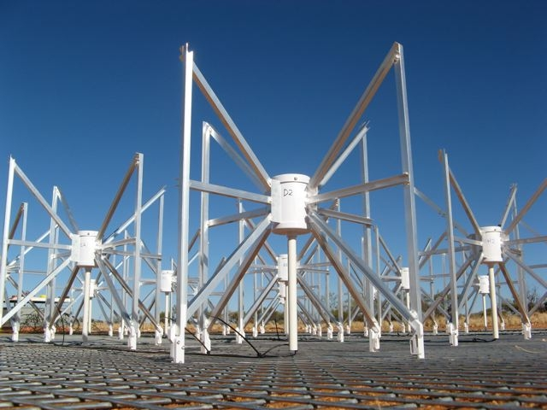
Project Completion
The hardware is now being completed and the software implemented.
The device will be taken to Australia to use for testing the beamformer components before their deployment to the telescope.
http://www.haystack.mit.edu/mwa/
Notes:
Picture of Outside

